Slide 1
Working with Views
Create a View
Manipulate Data in Views
Create Aliases
Modify and Drop Views

Slide 2
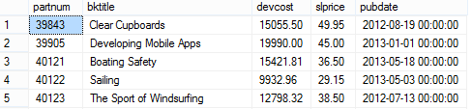
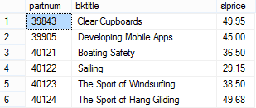
Views
Titles table is the source table
View retrieves records from the source table
View based on the Titles table
Does not store data

Slide 3

The CREATE VIEW Statement
The CREATE VIEW statement
Name of the view
Optional column names

Slide 4

Schema Binding
Binds the view to the table
Uses two-part table names

Slide 5
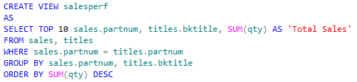
The TOP Keyword
The number of rows to retrieve
The TOP keyword
Search condition
Must include an ORDER BY clause

Slide 6

Insert Data Through Views
Use the view name in place of a table name
Must specify values for all columns that don’t permit nulls in base table
Values cannot violate the view’s definition if it has the WITH CHECK option set

Slide 7

Modify Data Through Views
View name
Changes title of book
WHERE clause restricts the change to a specific row

Slide 8

Delete Data Through Views
View name
WHERE clause identifies row to delete

Slide 9

Aliases
Table alias
Column aliases
The AS keyword
Table name

Slide 10
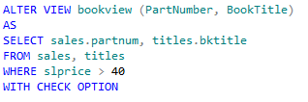
The ALTER VIEW Statement
The ALTER VIEW statement
View name
SELECT statement defines columns included in view
Configures view to not permit changes to data that violate the WHERE clause

Slide 11
The DROP VIEW Statement
The DROP VIEW statement
View name

Slide 12
Reflective Questions
How does your organization use views?
Does your organization use views to generate reports? Why?

